Slide 1
Work Status
Weekly Update - 05-13-20

Slide 2
Weekly Update
In detail examination - Deadline effect
Working Session
Resting Baseline
Linear modeling
Raw Resting Baseline
RR
RR
QC1
Validation Plotting
Recheck significance

Slide 3
In detail examination - Deadline effect

Slide 4
In detail examination - Deadline effect
Day1 and Day2
\bar{ ln( W_S_i^D_j - \bar(B_S_i) + abs(min(W)) + 0.001 )}
Average of working session
Normalized by vanilla day
Deadline Day - min(Day3, Day4)

Slide 5
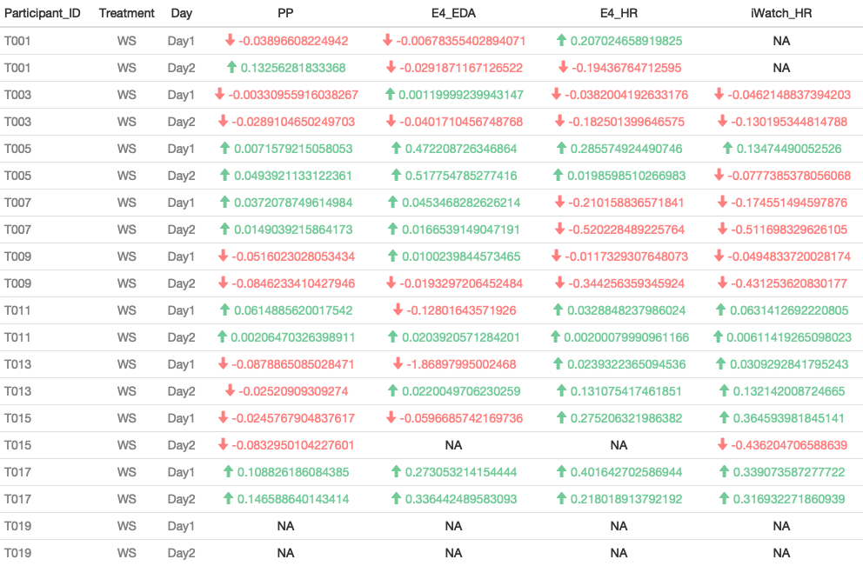
Deadline Effect - Working Session

Slide 6
Linear Modeling - Resting Baseline

Slide 7
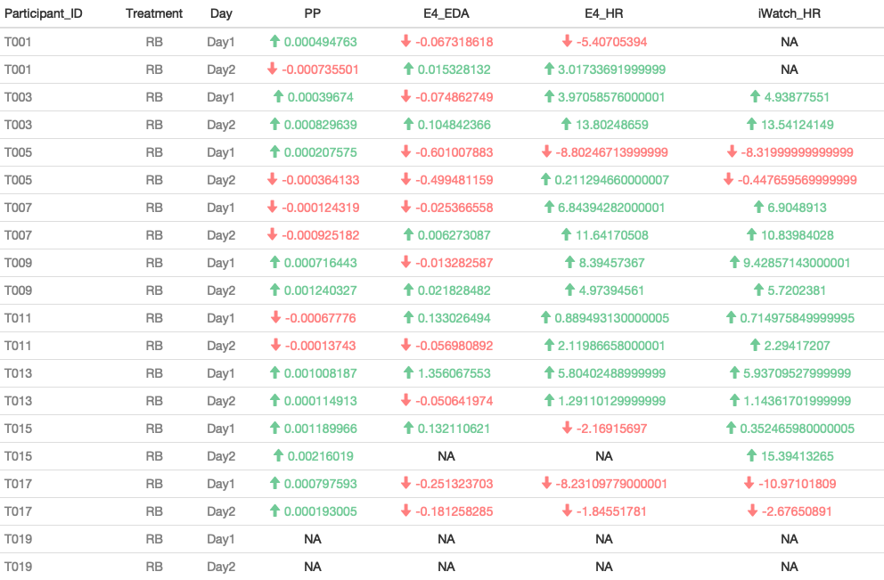
Deadline Effect - Resting Baseline

Slide 8
RR - QC1

Slide 9
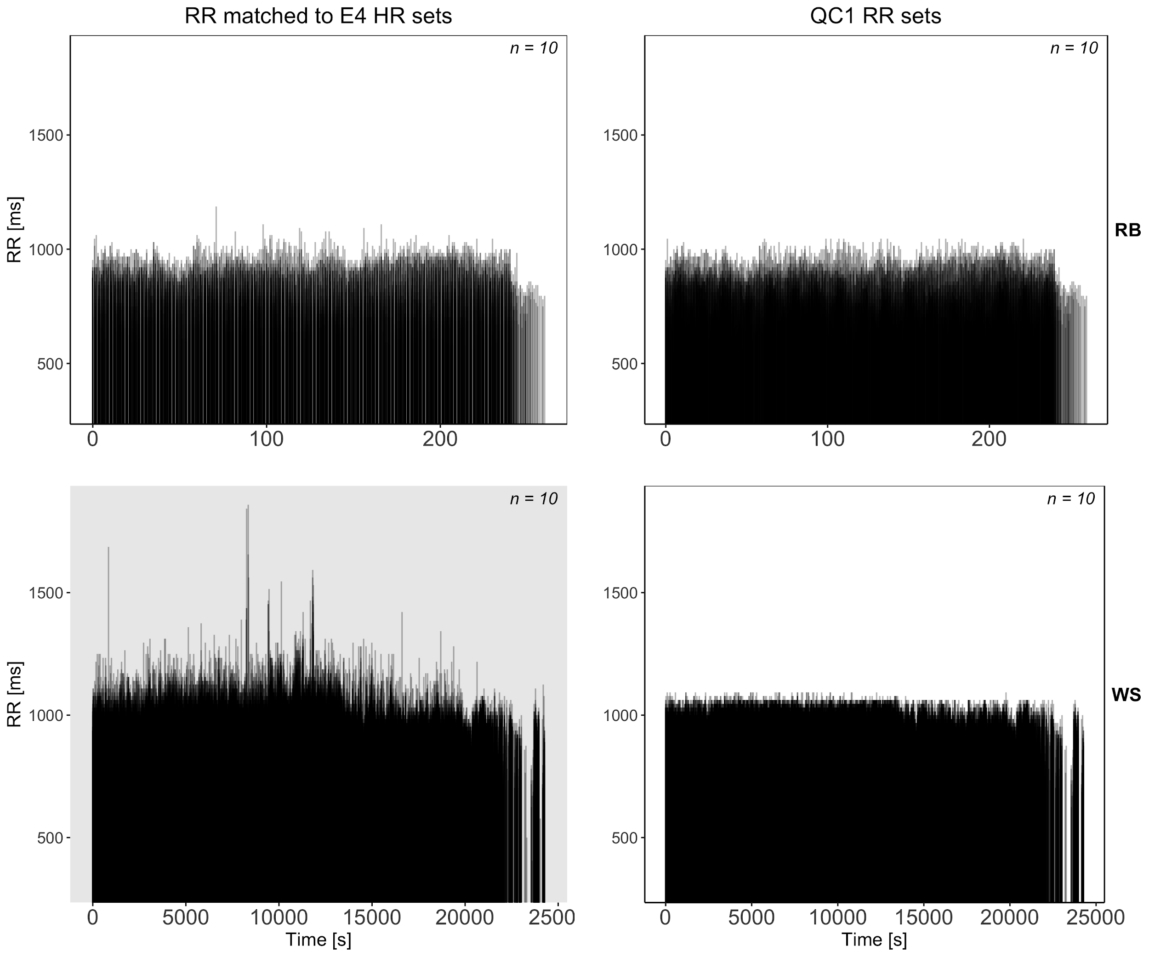
RR- QC1

Slide 10
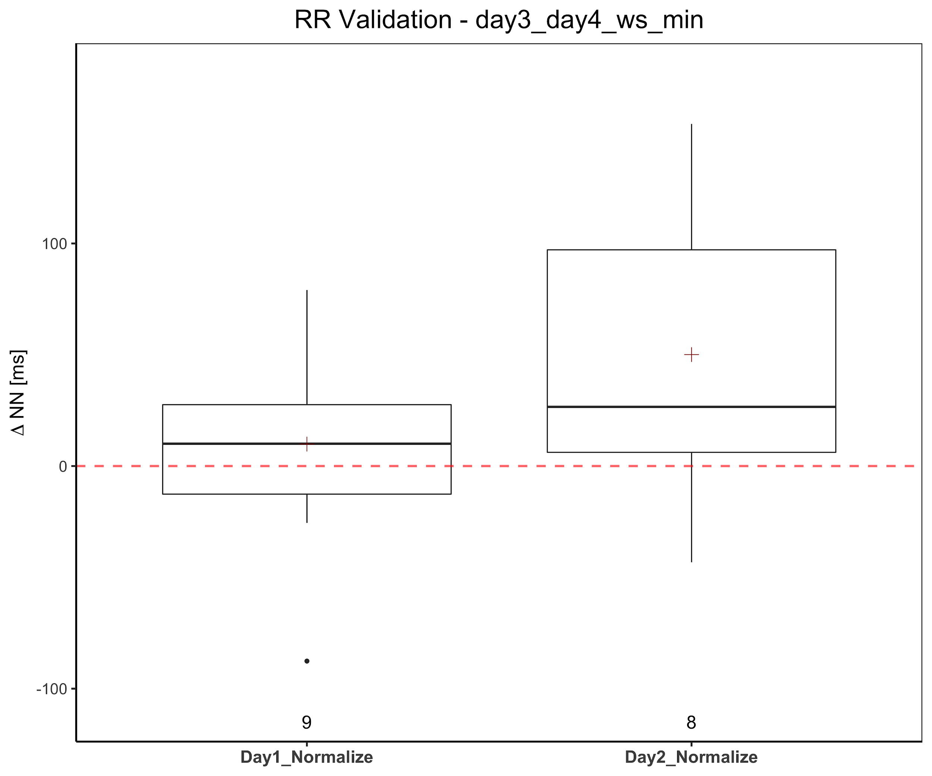

Slide 11
Thank you

